Slide 1
Chain of Thought
Ehsan Gholami
Chang Liu
Qiwei Li
Xincheng Lei
UC Davis
Winter 2016

Slide 2
Motivation

Slide 3
Imagine this…
You need to read a newly published physic paper.
Terms used in the paper are very hard.
You really really want to read some important references of that paper.
Don’t you want a tool that can show you the “chain of thought”?
Yes, you do.

Slide 4
Data Collection

Slide 5
Sources of data: IEEE Xplore Digital Library
Query Format:
http://ieeexplore.ieee.org/xpl/FEATURE.jsp?arnumber=NUM
FEATURE:
articleDetails
abstractReferences
abstractCitations
abstractKeywords

Slide 6


Slide 7


Slide 8
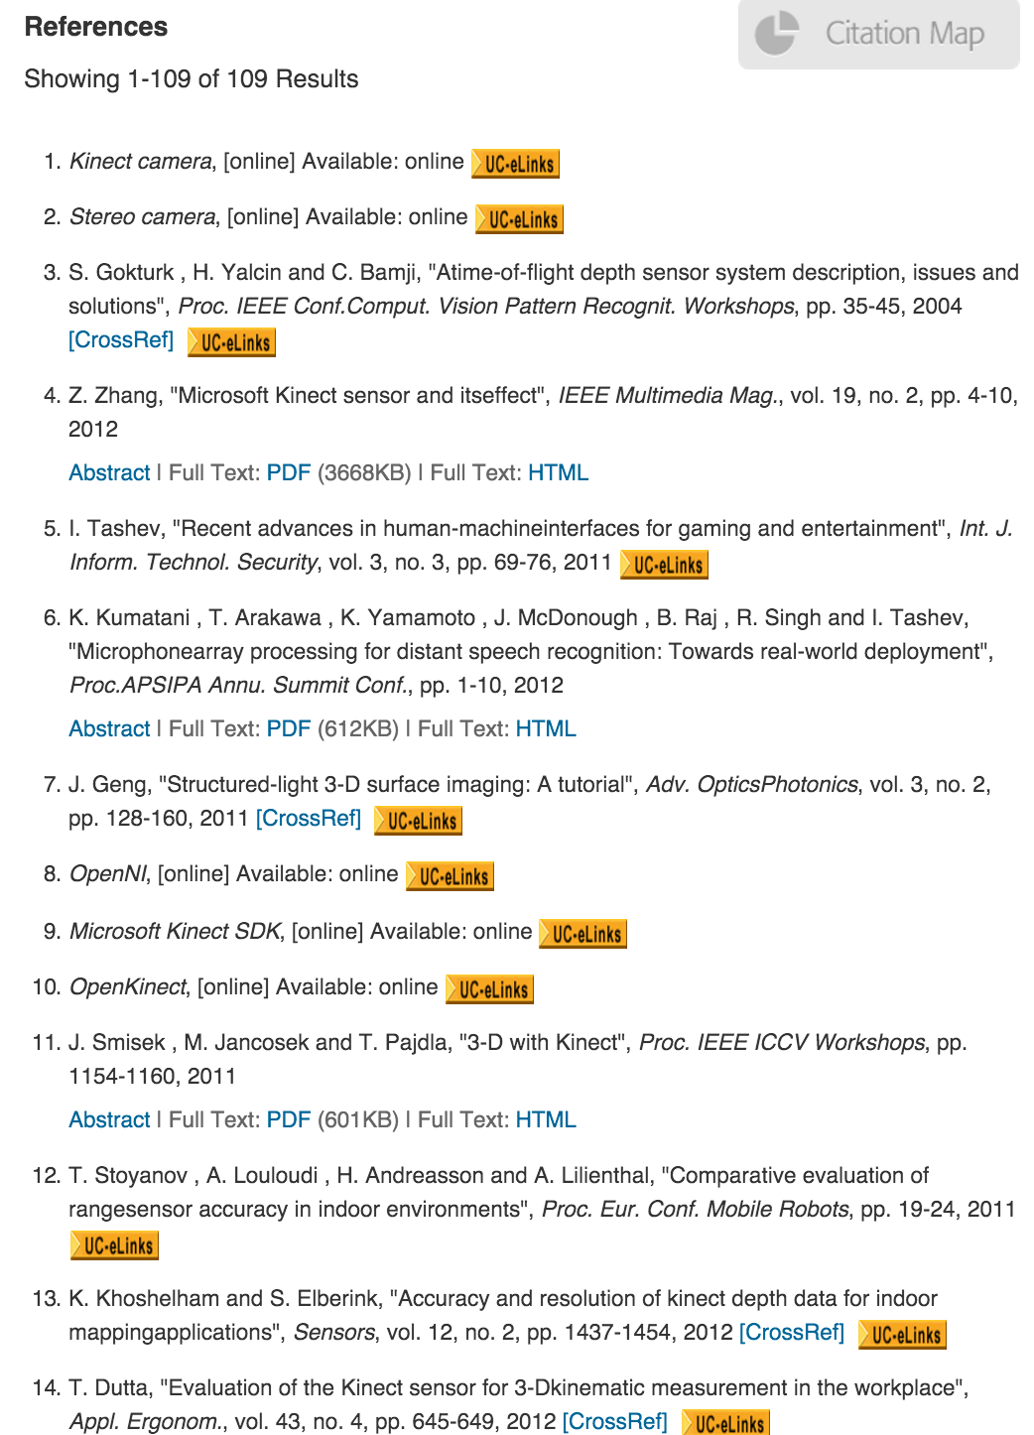
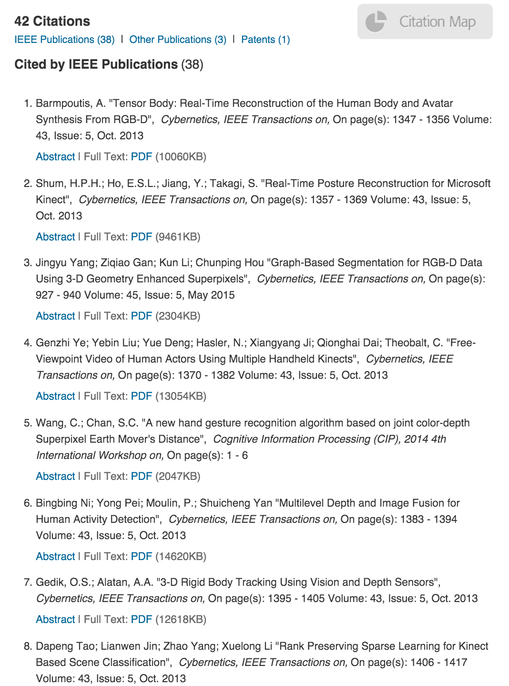

Slide 9
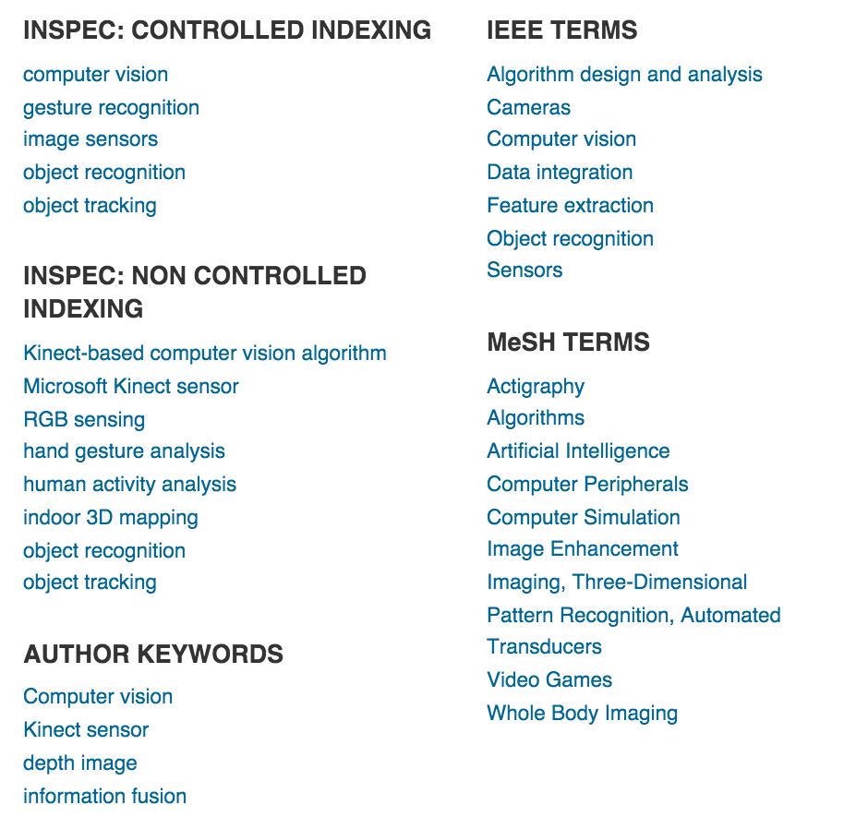

Slide 10
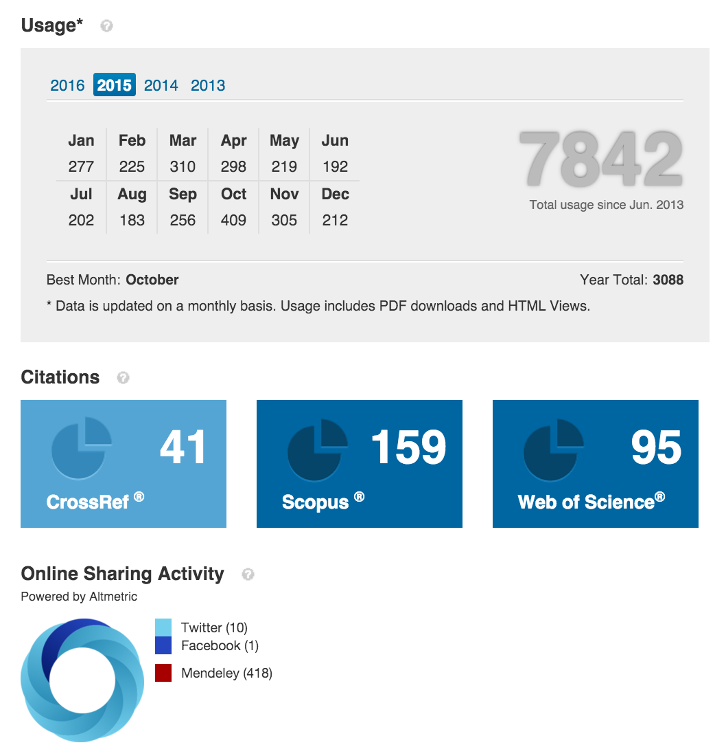

Slide 11

Not good if explore the whole database without any filtering, because...
Too many papers!
Number of publications just in IEEE library: Over 4,000,000 items
Time for access a single article: 3~6 seconds. (over 5 months to capture all the information of the whole IEEE publication library)
Our target:
Input: a seed paper.
Output: a network of reference or citing papers associate with the seed paper.
What we want to see:
Origin of the chain of thought
Significant breakthroughs (or bottleneck) in the path from origin to current research

Slide 12
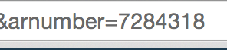
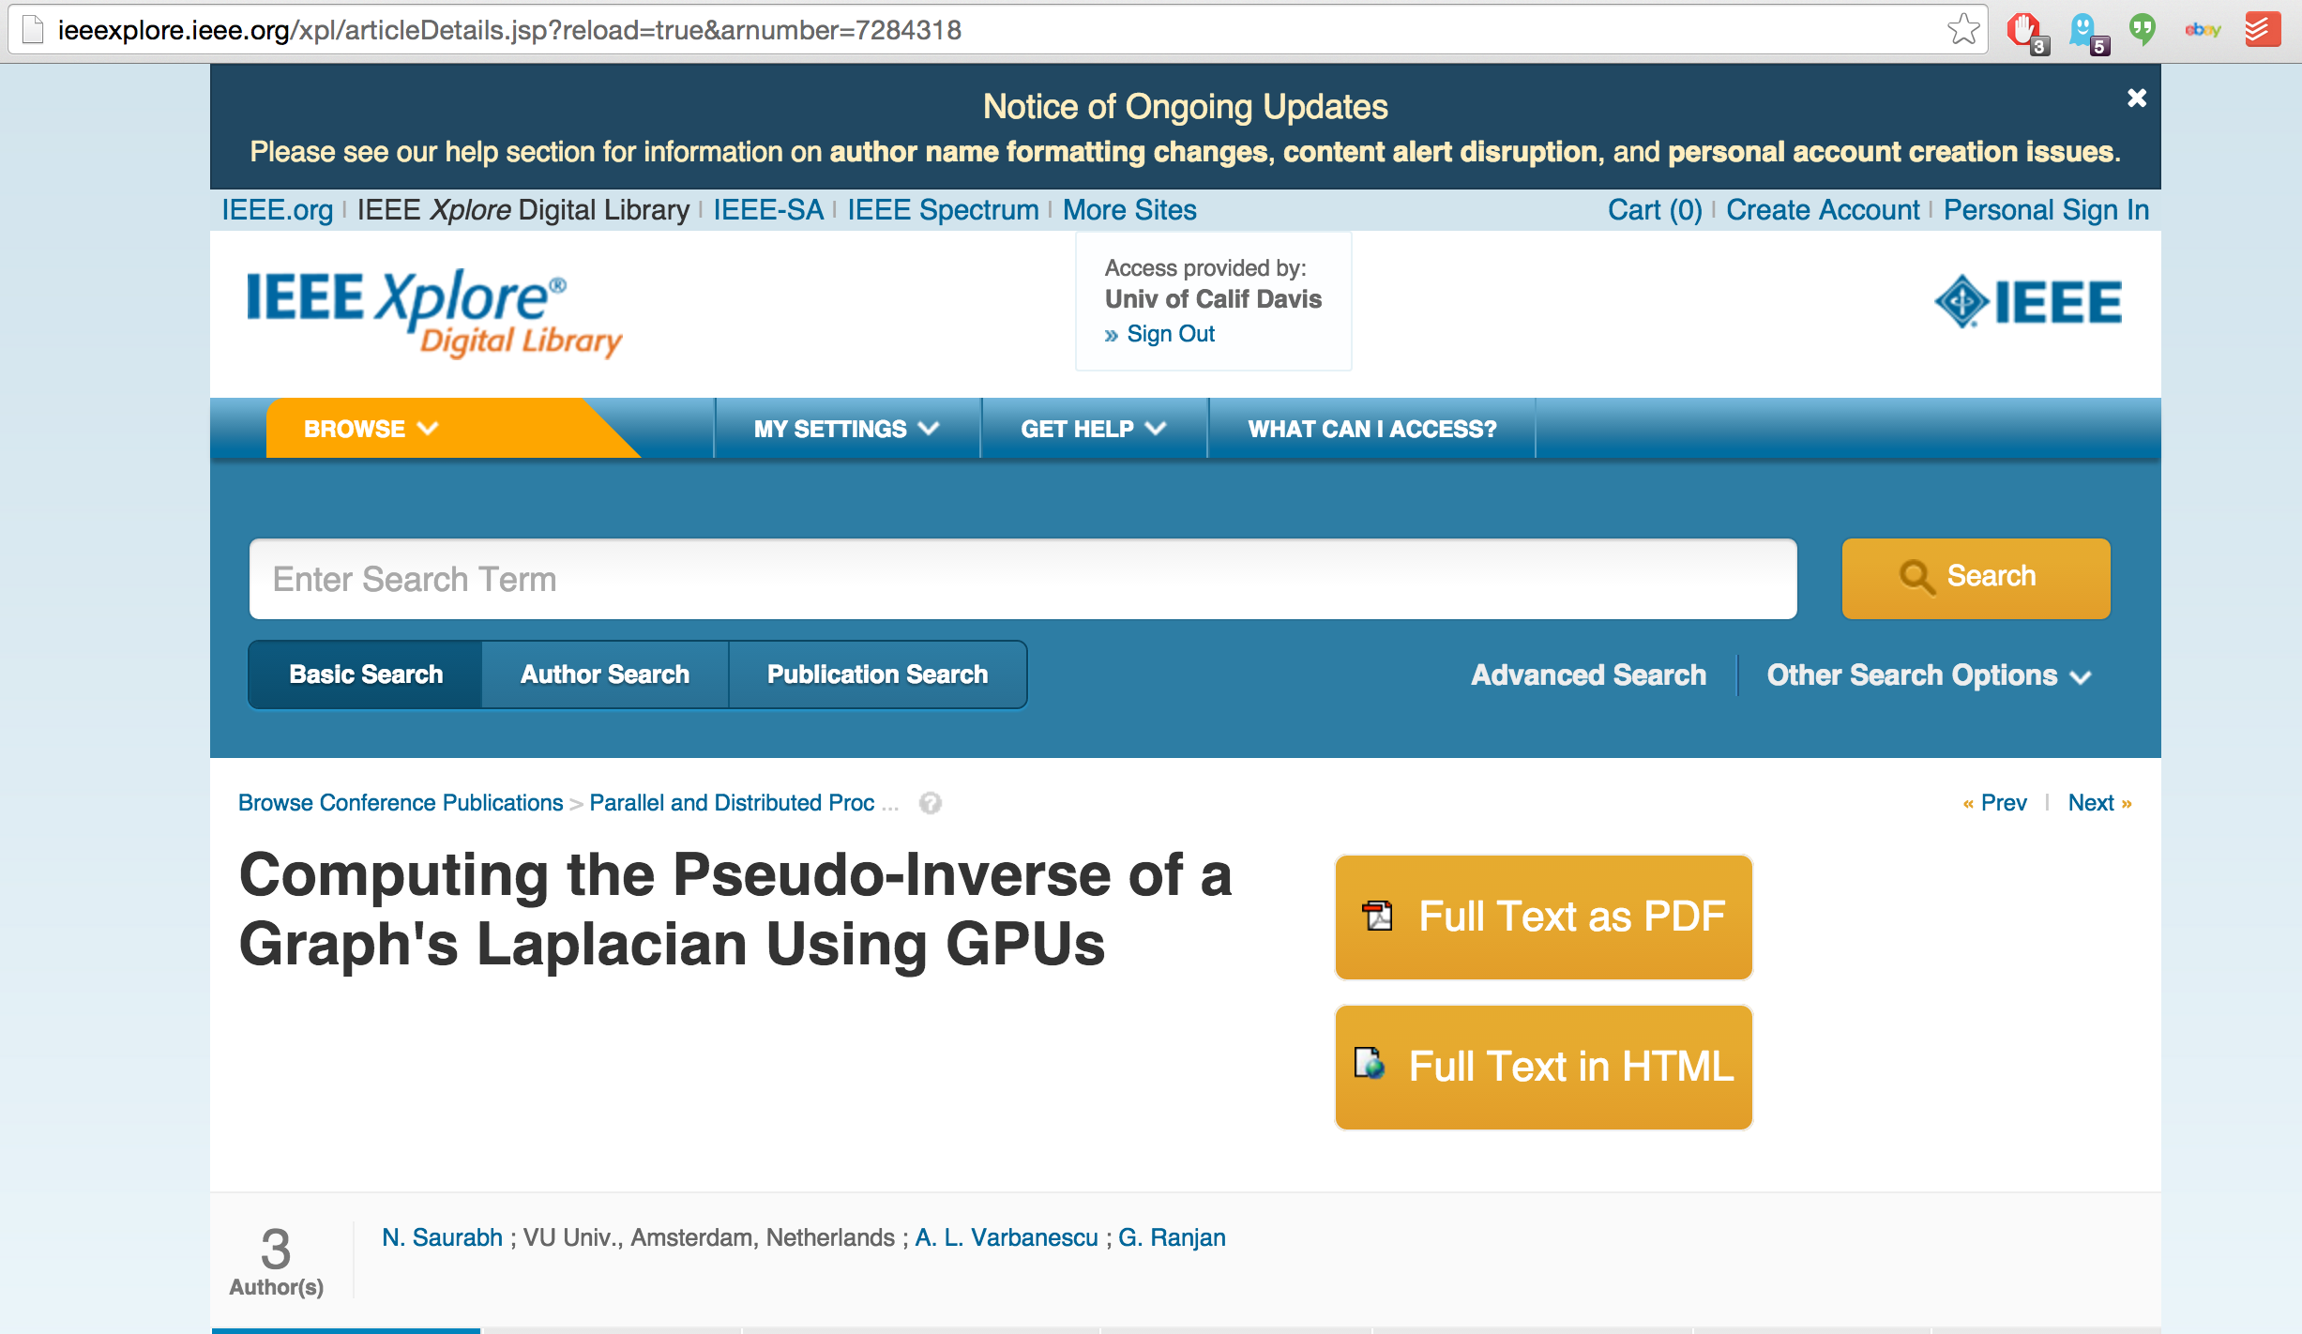

Then we just follow the reference flow...
Seed

Slide 13
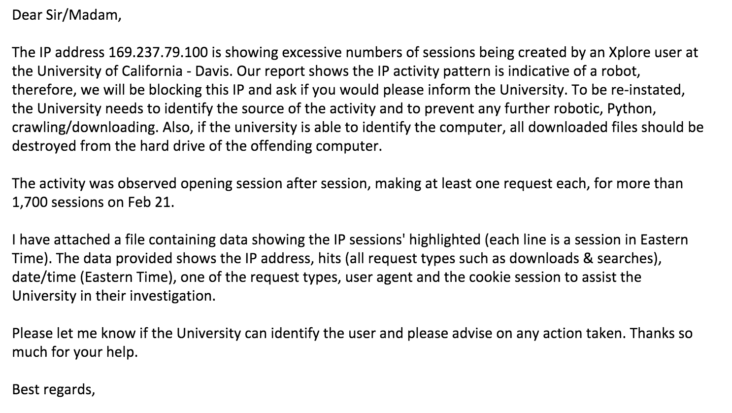
Then this happened

Slide 14
Data Munging

Slide 15
We need to control the diverging by filtering important references
What kinds of paper are more likely to be knowledge source?
Breakthrough discovery and invention ~ High citation
Frequency of citation in the seed paper’s field

Slide 16
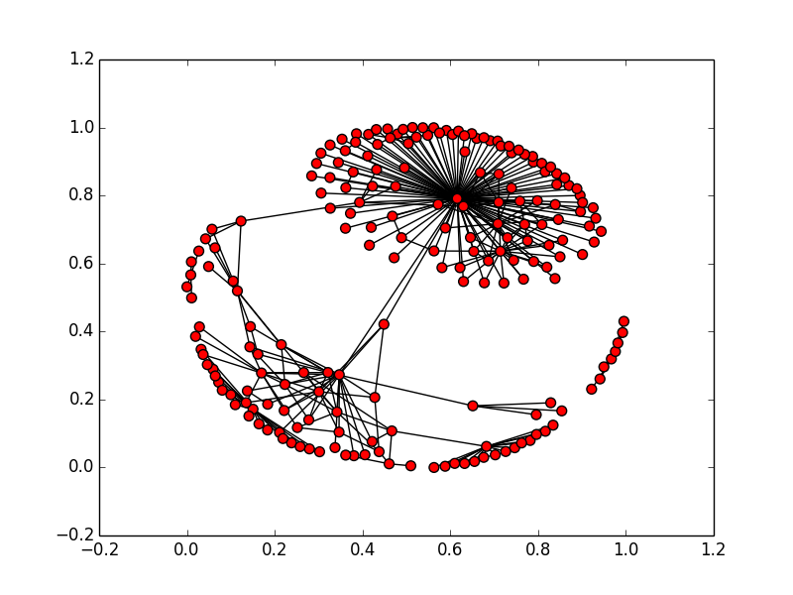
Except review papers cite too many irrelevant articles
So our filtering is by the rank of a score to each article:
Score = Citation^a * Frequency^b * Relevance^c
Relevance between two papers =
(# of common keywords) / (# of keywords in cited one)
How many references pass the filtering?

Slide 17
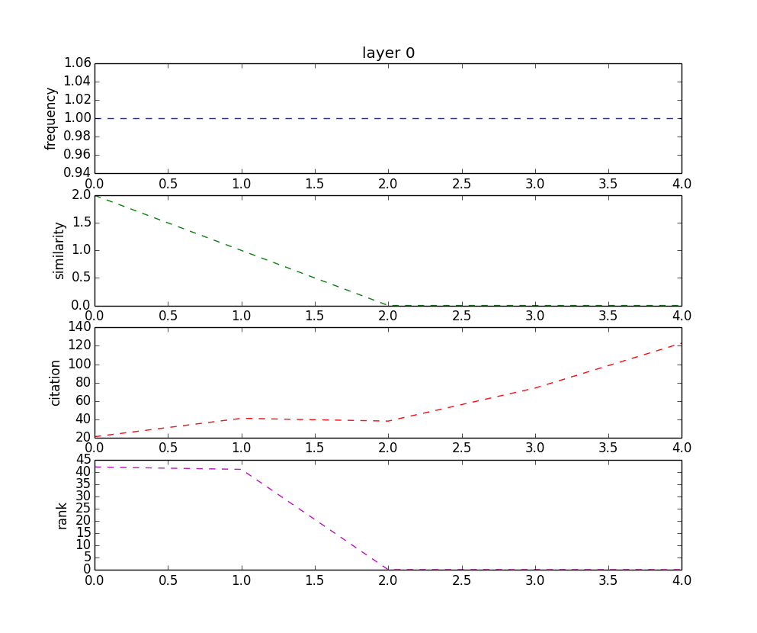
Keep useful data

Slide 18
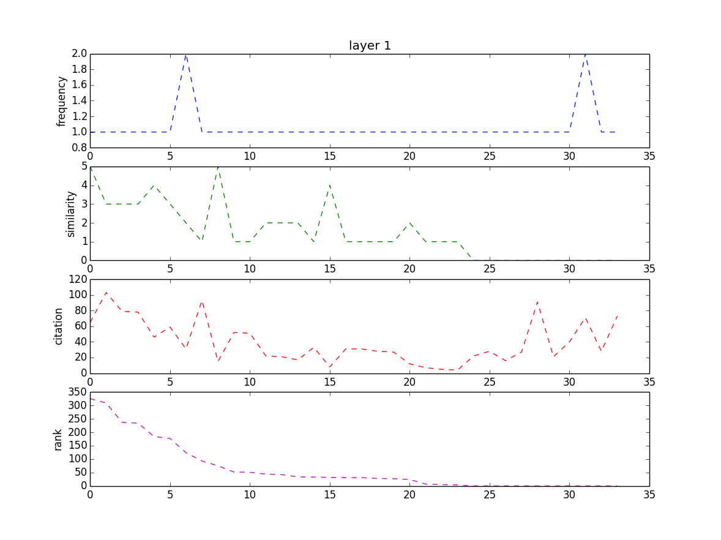
Keep useful data

Slide 19
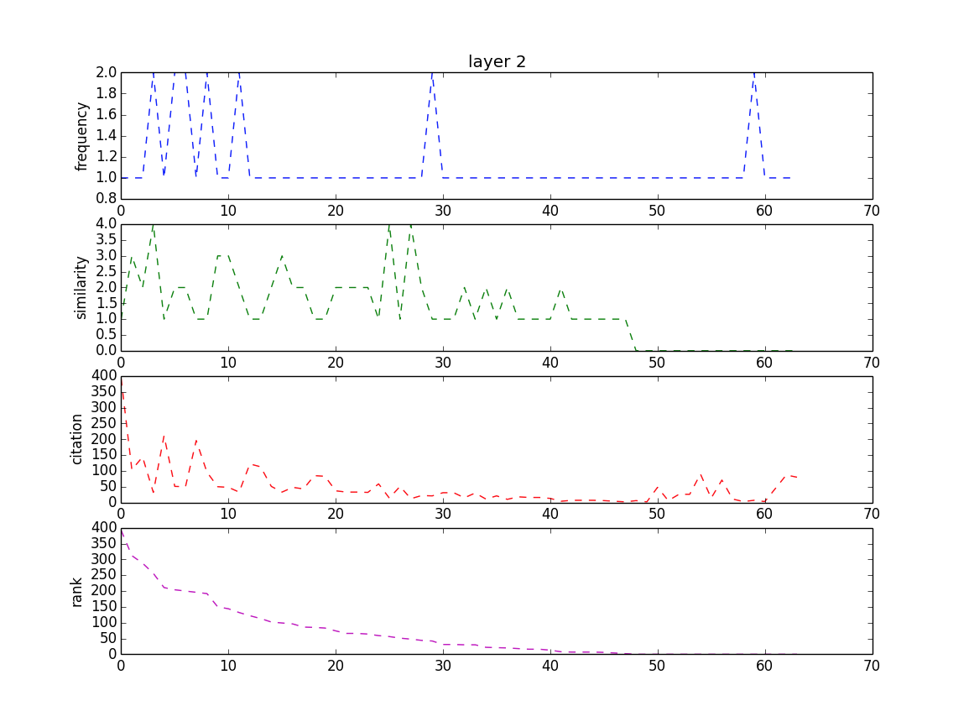
Keep useful data

Slide 20
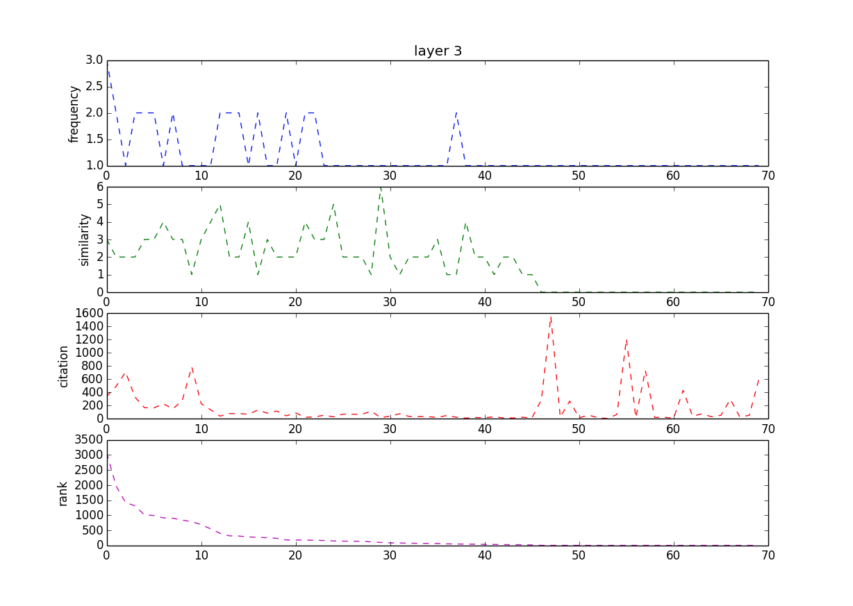
Keep useful data

Slide 21
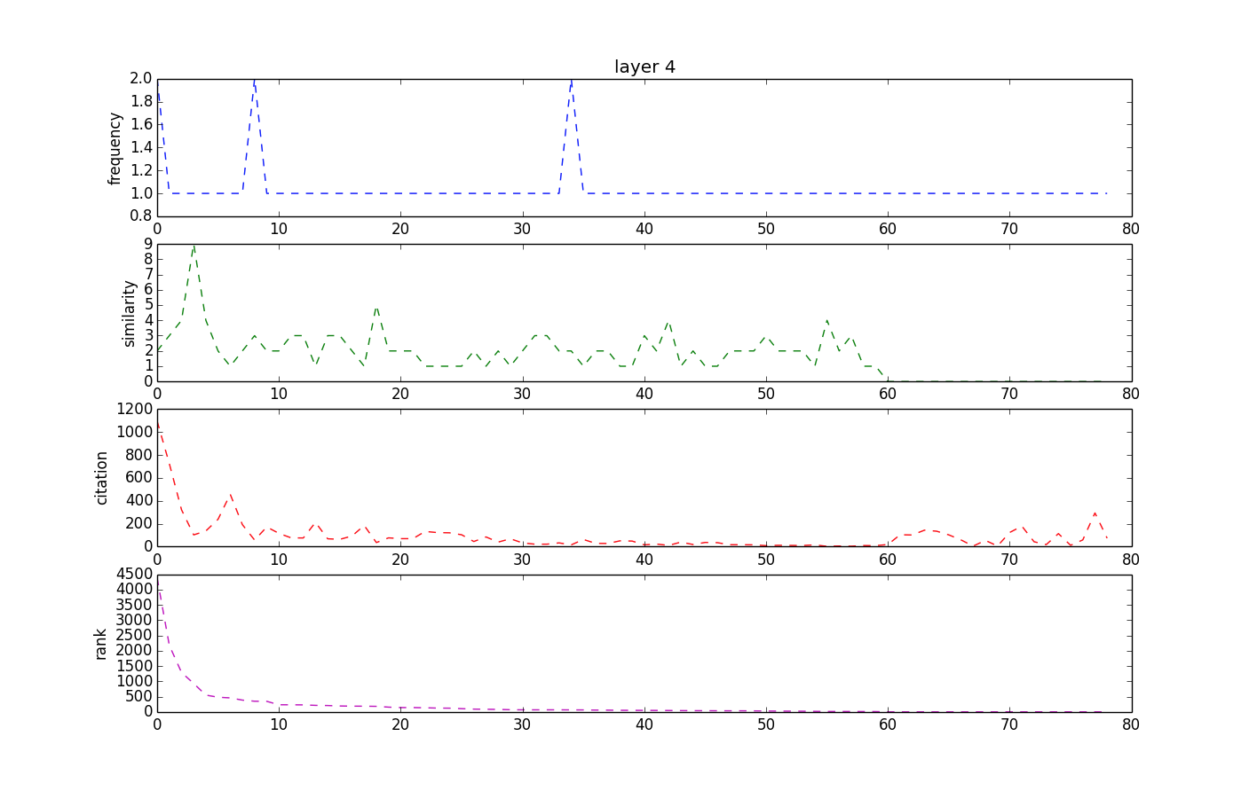
Keep useful data

Slide 22
Approach
Seed node
Time

Slide 23
Modeling

Slide 24

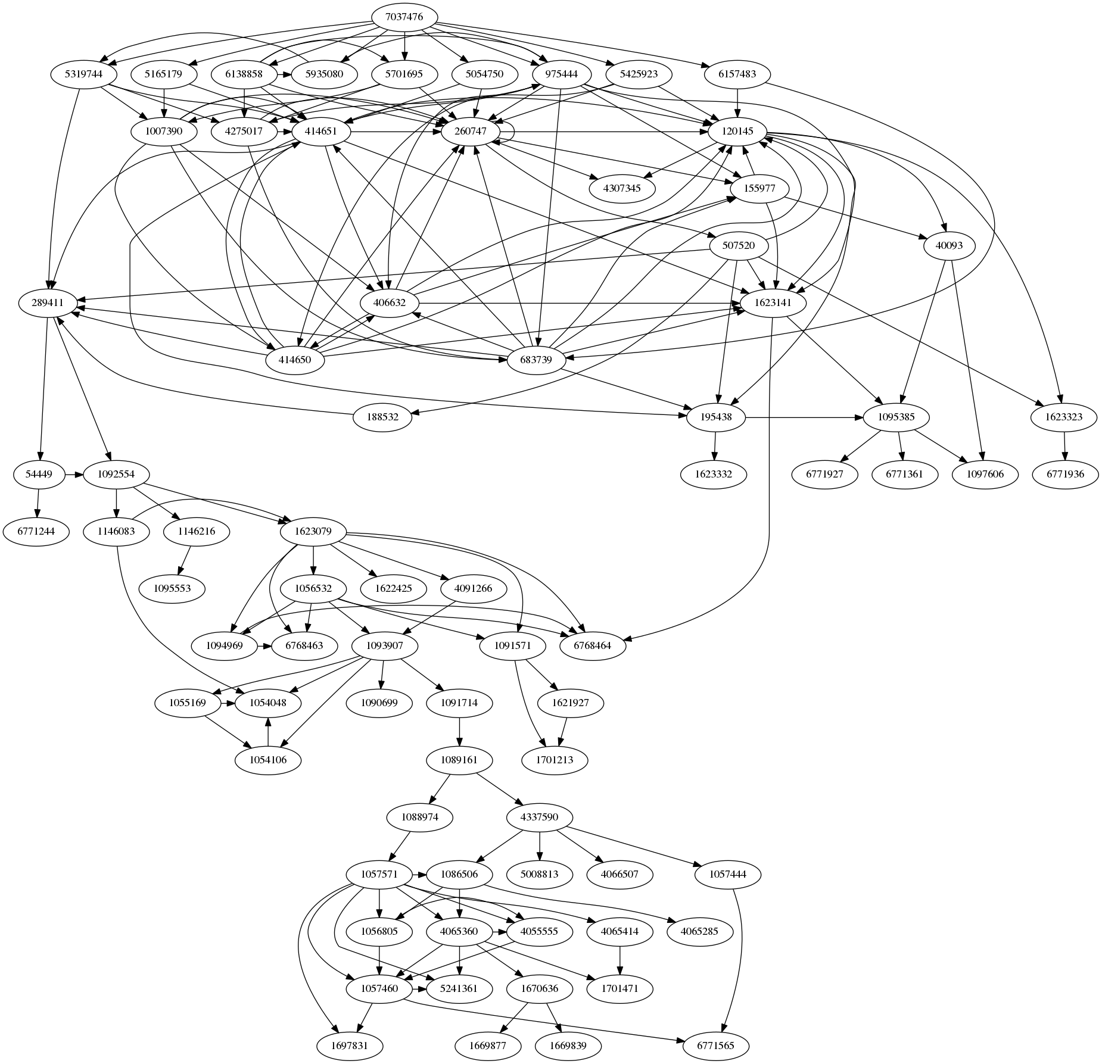
2014
1920

Slide 25
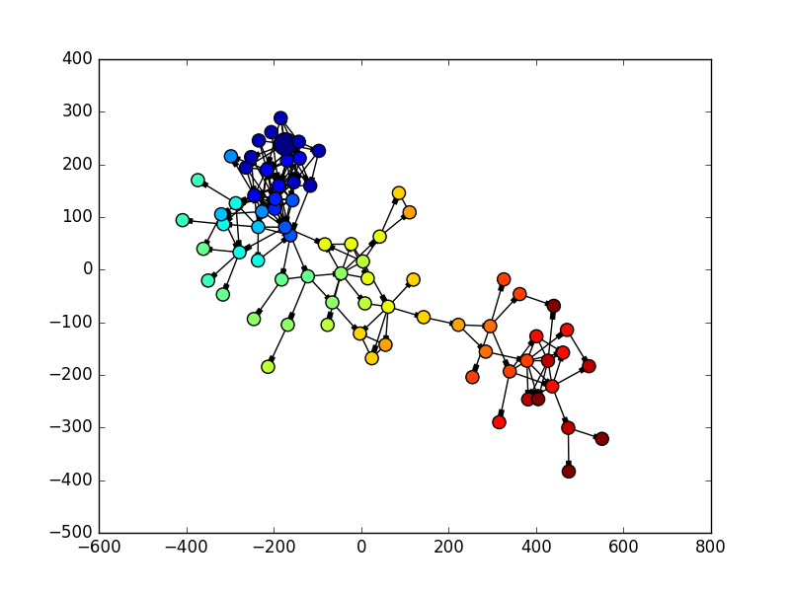
Color by layer

Slide 26
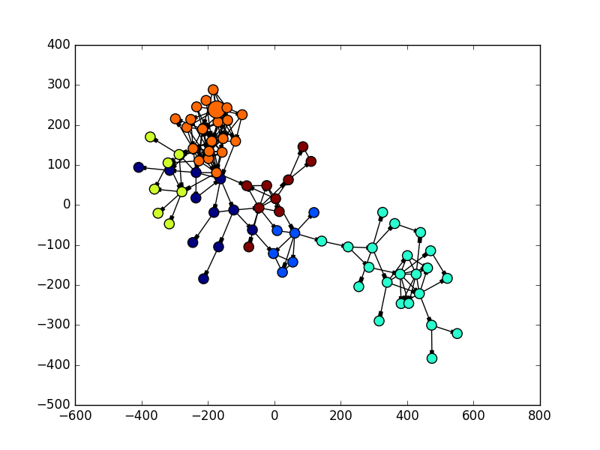
Color by community detection

Slide 27
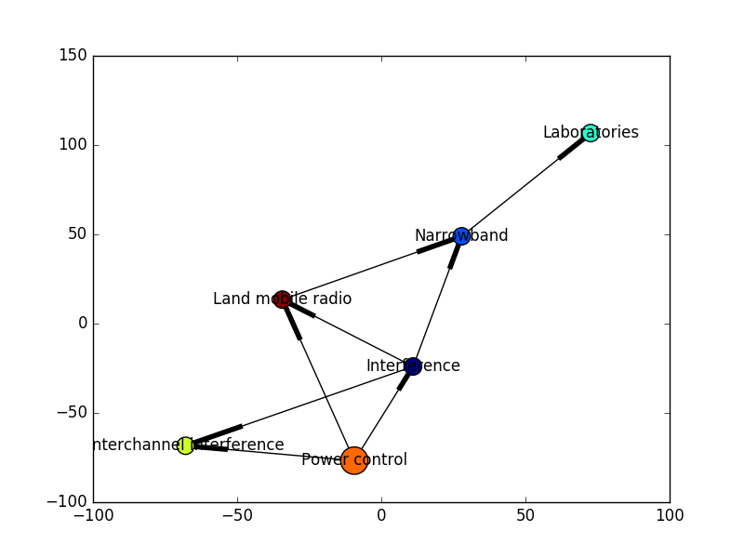

Slide 28
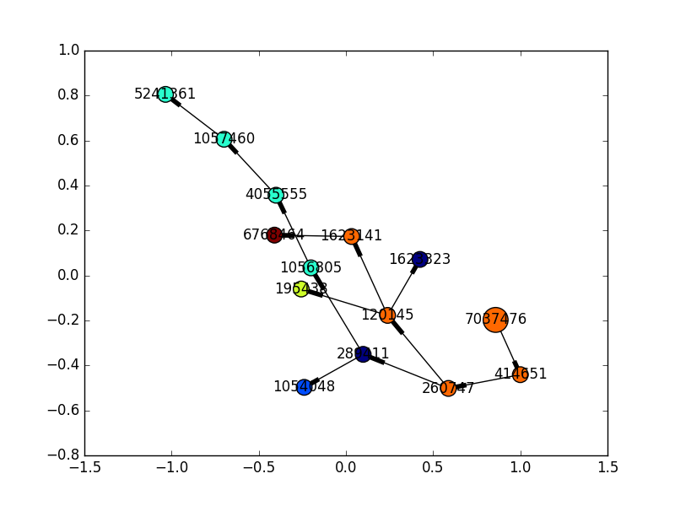

Slide 29
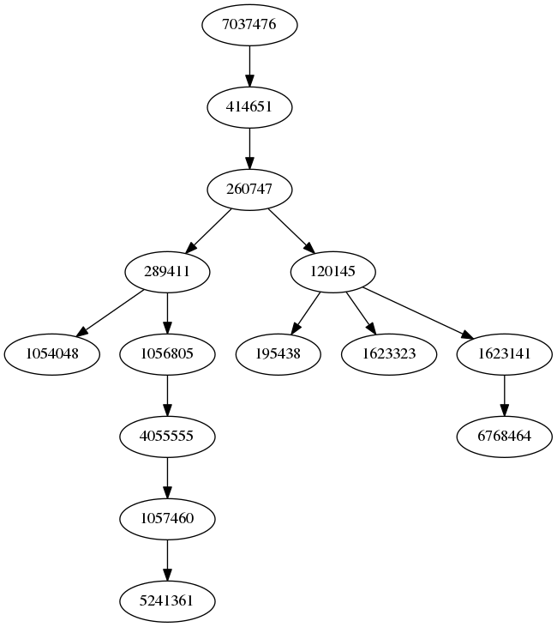
Power control and rate allocation for outage balancing in femtocell networks (2014)
Performance of optimum transmitter power control in cellular radio systems (1992)
On the capacity of a cellular CDMA system (1991)
Information theory and inverse probability in telecommunication (1952)

Slide 30
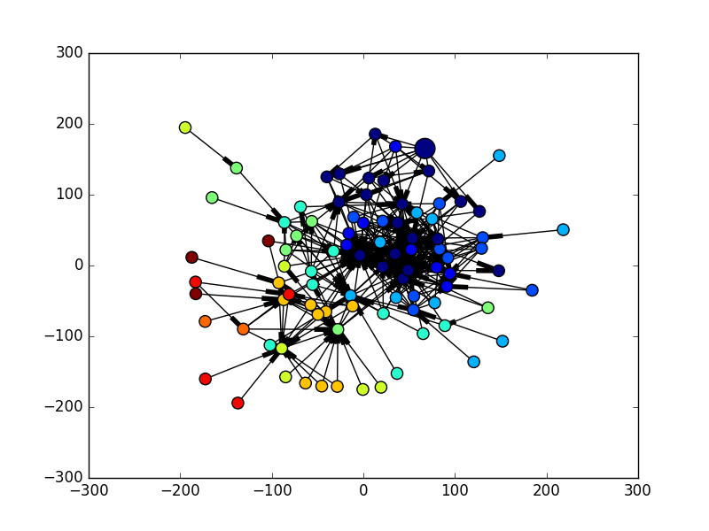

Slide 31
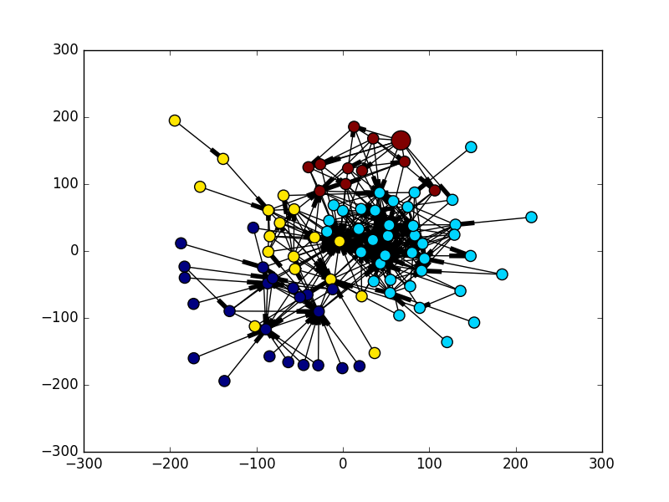

Slide 32
If use another filtering
Score = Citation * Frequency * Relevance
Seed paper:
Enhanced computer vision with microsoft kinect sensor: A review(2013)
Output paper:
Application of the Karhunen-Loeve procedure for the characterization of human faces(1990)
Shape matching and object recognition using shape contexts(2002)
Fourier Descriptors for Plane Closed Curves(1972)
Training support vector machines: an application to face detection(1997)
Least-Squares Fitting of Two 3-D Point Sets(1997)
A method for registration of 3-D shapes (2002)

Slide 33
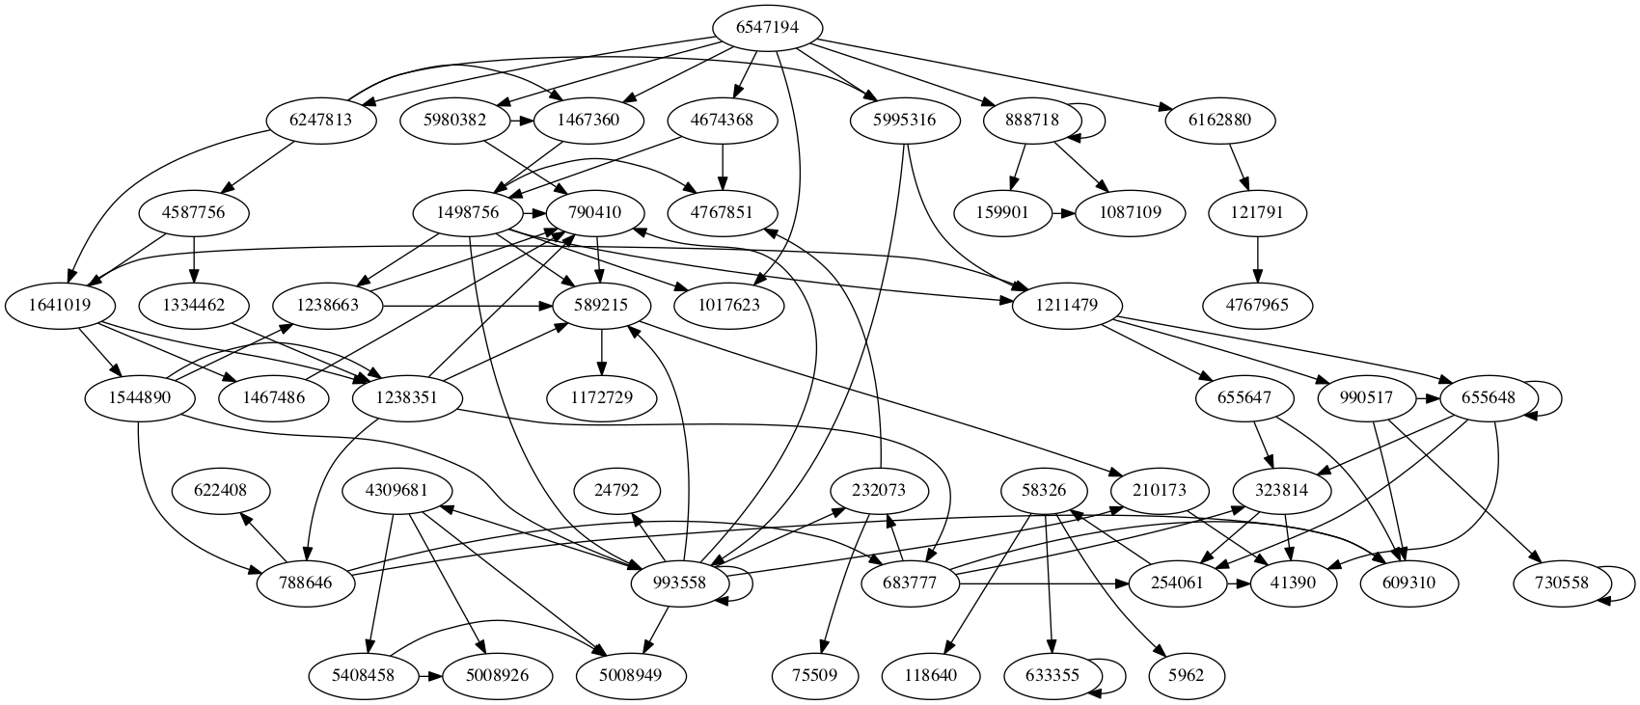

Slide 34
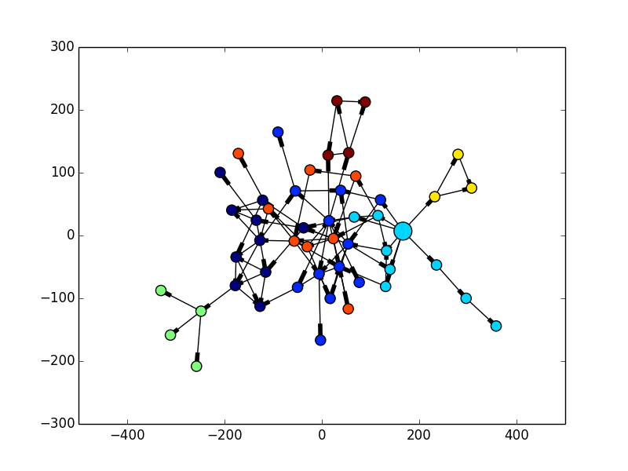
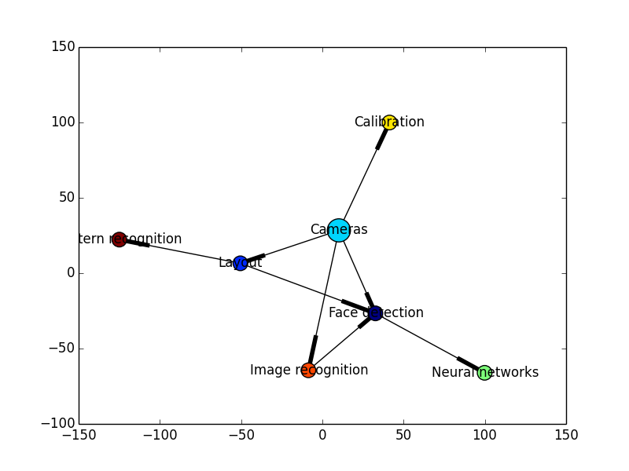

Slide 35
Evaluation

Slide 37
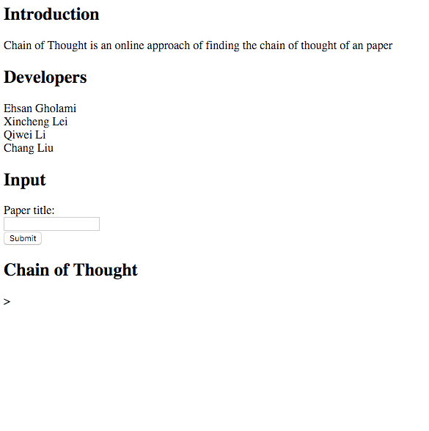
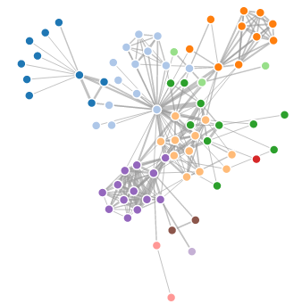
UI
Under construction
Two approaches
Python function
Python server

Slide 38

Thank you
?

